Slide 1
Health Services Enterprise (HSE) Release 1 - The Exchange - Recommendations for 01Oct Scope - May 29th, 2013
Mike Maslack
Program Manager - Health Services Enterprise
mike.maslack@partner.state.vt.us
Enroll, Operate, Optimize

Slide 2
Contents
Summary of Changes
Overview
Recommended Scope
Business Architecture & Capabilities
Illustrations
Customer Support Principles
Notices
Self-Attestation Illustration
Identity Management Illustration
Master Data Management Illustration

Slide 3
Summary of Changes
This analysis, when measured by the RTM contents, shows less than 5% change recommended:

Slide 4
Overview

Slide 5
Analysis Background
Objectives:
Define what’s in and out of the 01October release of the Exchange
Inform System Design artifacts and FDDR
Participants:
Melissa Boudreault, Matt Kristin (CGI), Paul Knollman (Oracle), Justin Tease (SoV), Mike Maslack (Desai/SoV)
Guiding Principle - Enable an Enrollment-driven framework of capabilities for the Exchange:
01Oct2013: Enrollment
01Jan2014: Operation
Post-Jan 2014: Optimization

Slide 6
Analysis Background
Inputs used to inform the analysis:
BPM inventory
Business Lead must-haves (October or later)
Policy must-haves (October or later)
Impacts of manual process work-arounds
Capability mapping
Out of the box
Configurable
Customizable (existing + new module)
Out of scope
RTM inventory
Business architecture
From HBE analysis
From CGI analysis

Slide 7
Plan for Closure
Objective: Approval of 01Oct scope by eod Wednesday (late)
Next Steps
Thursday 30May
Publication of final Scope package (ppt and RTMs) to BLs and Leadership
Friday 31May
Scope package will go to Change Control process unless issues are raised by HBE Leadership to cause delay
Follow-on
Briefings with ACCESS Remediation team (workshop 10Jun week)
Inform system design artifacts, FDDR and project plans/resources

Slide 8
HBE Scope and Hierarchical Mapping
Business Processes are the foundation for HBE Scope
All major HBE artifacts will be mapped and have relationship to Scope
Scope Hierarchy & Mapping
HBE Business Objectives
CMS Blueprint & Supplemental Guidelines
Business Process Models (BPM)
Stakeholder Business Requirements (RTM)
OneGate/CGI & SOV Infrastructure/Platform Solution
Test Scripts
User Acceptance
Deliverables
for current
Scope
exercise

Slide 9
Recommended scope

Slide 10
Components of Recommendations
Decomposed and reconstructed look at Exchange processes
CUSTOMER SUPPORT
ELIGIBILITY & ENROLLMENT
PLAN MANAGEMENT
FINANCIAL MANAGEMENT & PREMIUM PROCESSING
ISSUERS
BROKERS/NAVIGATORS

Slide 11
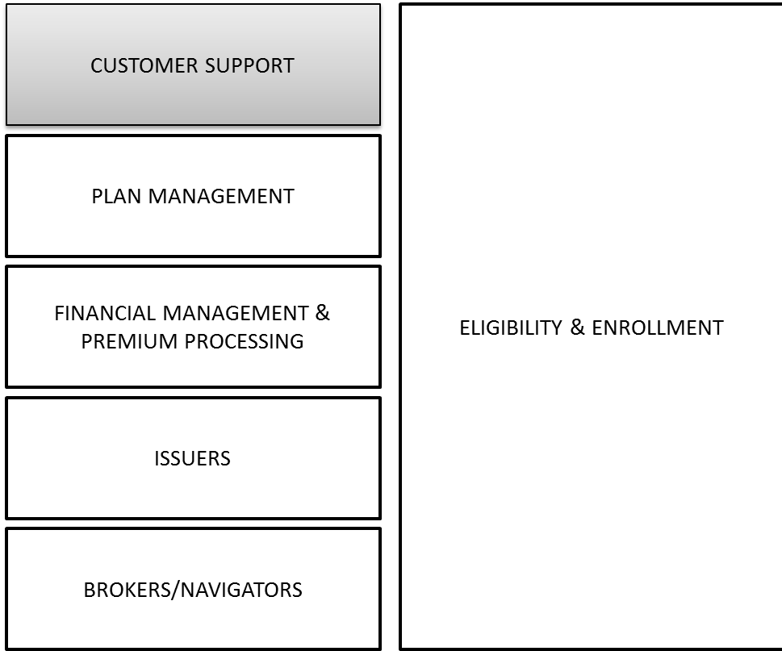
Customer Support
What’s in Oct
What’s after Oct
Siebel CRM for Service Request Mgt
One Queue, Five Workflows
Appeals
Eligibility Re-determination
SR Escalation
Application Siebel State Transition Model
SR Siebel State Transition Model
Type, Area and Sub-Area classification
Enrollment Notices
Basic Service Request processing
Basic Reporting
Call and Service Request ‘counts’
Base Service Analytics module
OneGate CRM and Portal
Call receipt and tracking in Maximus as-is
Call type = Maximus for non-HBE calls
‘Navigator’-like assistance functions
Manual processes for:
Escalation, Appeals and Grievances
Assignment of Service Request
Search and Scripts
Telephony integration
Advanced Customer Service workflows and routing
Advanced Service Request processing
Auto Escalation Management
Auto Workflow for Appeals and Grievances
Auto Assignment Manager
Auto Activity Plans
Advanced Service Analytics
Regarding 01Sept. Capabilities:
Call tracking in existing system
Manual Service Request tracking
Fixed information gathering, with bulk load to Siebel 01Oct for historical view

Slide 12
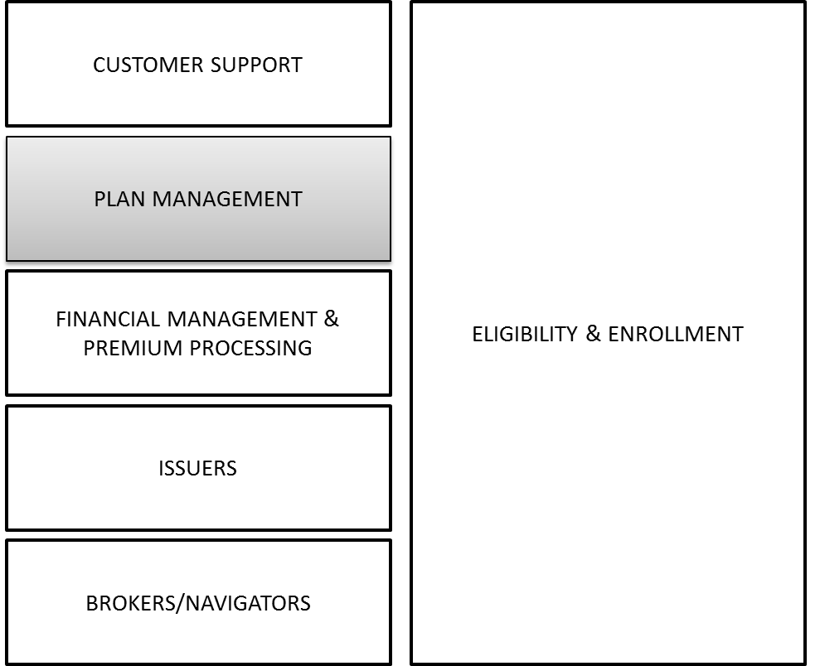
Plan Management
What’s in Oct
What’s after Oct
Unchanged
Unchanged
Regarding Plan Mgt Scoping:
Scope for Plan Mgt was fixed by State in Dec/2012, to include support for manual processes with SERFF

Slide 13
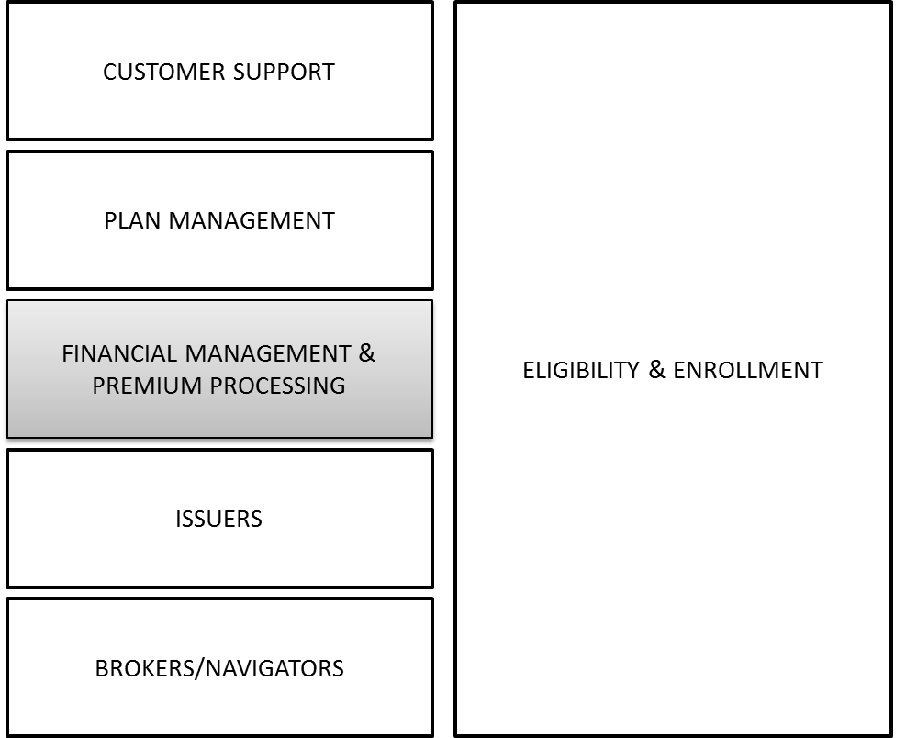
Financial Management and Premium Processing
What’s in Oct
What’s after Oct
Premium Processing
Credit Cards
ACH/Bank Routing
Check
Manual Refunds to Individual and Employer
Premium Assistance Calculation
Basic Enrollment Reporting
Updates to GL, to include codes sufficient to enable HBE reporting from Vision
APTC/CSR for Fed & State
VCSA and VPA for State
Carrier Payments
Hierarchical Payments (Payment processing sequence)
Reconciliations
Advanced Reporting
Advanced Analytics
Annual FCSR Reconciliation
NSF Processing

Slide 14
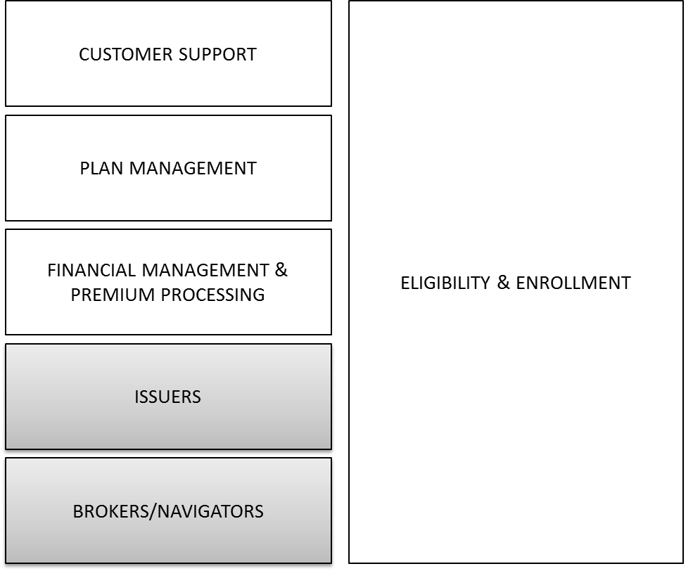
Issuers, Brokers and Navigators
Issuers
What’s in Oct
What’s after Oct
Accept, Validate and Reconcile Enrollments
Remittance
Premium Reconciliation
Issuer CSR teams, orchestrating with SoV
Nothing Explicitly Delayed
Brokers and Navigators
What’s in Oct
What’s after Oct
Functioning as an Assister for Enrollments
Nothing Explicitly Delayed

Slide 15
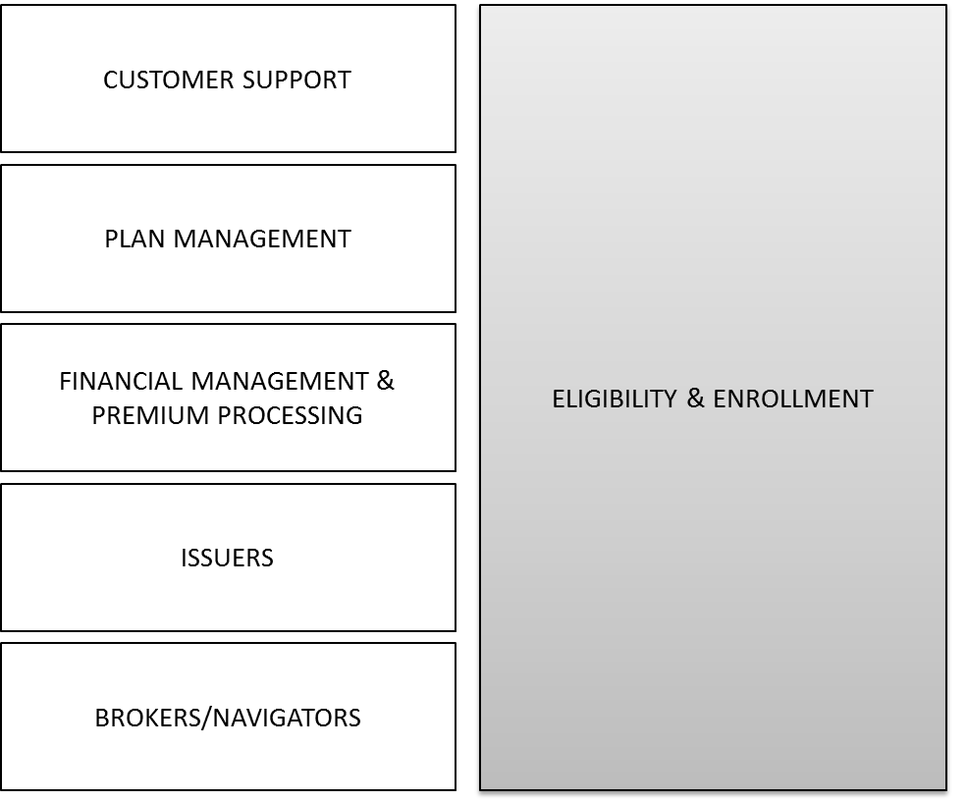
Eligibility and Enrollment, Individual
What’s in Oct
What’s after Oct
Eligibility
Community (QHP) and Public (MAGI Medicaid / CHIP) Plans
New + Existing (via ACCESS Remediation) data
Automated Eligibility Rules for Federal + State
Integration with CMS
Self-Attestation when Federal Hub unavailable (see Backup Material for details)
No integration with State databases except ACCESS
Limited ACCESS Integration
MMIS Plans
HBE to ACCESS Feed for MAGI updates
ACCESS to HBE Load for MAGI eligible
Enrollment
Input, Validation and Correction on-line
Plan Selection and Pricing
Carrier Enrollment
Initial Payments
Carrier QHP Reconciliation
State Interfaces
Expanded Access Remediation
Regarding MAGI Medicaid/CHIP:
MAGI Medicaid/CHIP eligibility determination will begin in HBE on 01Oct.
Anyone seeking Medicaid coverage for 4Q13 will be politely directed to existing state systems
MAGI Medicaid/CHIP enrollment applications will be accumulated in HBE until late Dec, at which time they are shipped to ACCESS for actual enrollment processing for 01Jan
HBE will implement periodic updates to ACCESS for any changes to client demographic data
ACCESS will implement a 9-month-long monthly transition for existing MAGI Medicaid/CHIP-eligible to HBE, as their renewal dates come near
All MAGI Medicaid/CHIP-eligible clients are moved to HBE as the system-of-record by year-end 2014

Slide 16
Eligibility and Enrollment, Small Business adders
What’s in Oct
What’s after Oct
Eligibility
Employer Eligibility (50)
Enrollment
Employer Plan Selection (full choice)
Employee Roster
Employee Enrollment Status
Employer Contribution
Initial Payment
Nothing Explicitly Delayed

Slide 17
Business architecture

Slide 18






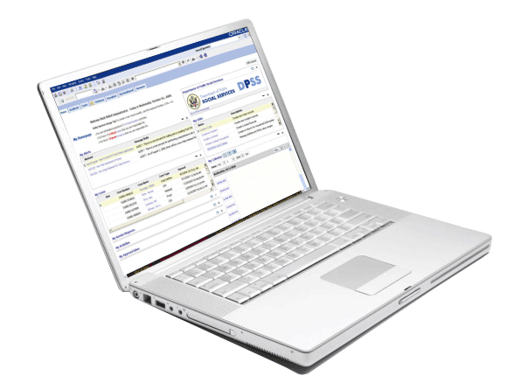





Business Architecture Typical for Health Services Enterprise (HSE)
Vermonters
Employers
Carriers
State Workers
Web
Phone, Fax, IVR
Chat
Email, Imaging
Local Office
Electronic
Transactions
Web
Phone, IVR
Email
Text
Local Office
Portals: Vermonters, Employers, Employees, Navigators, Brokers, State Workers
Business
Rules
Notice
Rules & Mgmt
Health Benefits Exchange (Individual / Small Business)
Integrated Eligibility
Health Insurance Exchange
Common
Information
Government Benefit Programs (TANF, SNAP, Medicaid, CHIP, ERDC, Other)
State Managed Offerings (Eligible for Federal Subsidiaries)
Enterprise Security
Individual
Security
Define
Household
QHP Insurance
Shopping
Eligibility
Determination
Appeal
Decision
Account View
MAGI
Rules
Enrollment Notices
Screening
Application
Intake
Verification
Marketing
Screening
Eligibility
Subsidy Calculation
Qualified
Health
Plan Rules
Financial Notices
Outreach &
Education
Security to view
others Info
Subsidy & Tax Calculations
Collaboration
Options
QHP
Enrollment
Change of
Circumstance
Employer
Reporting
Eligibility
Benefit Plan
Service Plans
Provider Mgt.
Enrollment
Premium Billing
Premium Collection
Carrier / Plan Mgt.
Integrated Eligibility Social Services
Content Management
Anonymous
Browsing
MAGI Insurance
Shopping
Submit
Documentation
Side by Side
Compare
MAGI
Enrollment
Secure
Messages
Payments
Federal
Rules
Vermont
State Rules
Document & Image
Workflow
Identify & Access Mgt
CRM Call Center Case Management
Activity Management
Workflow
SR Management
Investigations & Appeals
Call Center & Case Mngt
Case Management
Service
Request Mgt
Workflow &
Queues
Investigations & Appeals
CTI & IVR
Policy
Modeling
Enterprise Storage
Real Time
Near Real Time
Batch
Enterprise Integration Services
SOA
ETL
MDM
Data (at Rest)
Data Management
Business Intelligence
Premium
Processing
Enterprise Financials
Insurance
Carriers
Federal Data Services Hub
Structured Data
System
Auditing
& logging
Invoicing and Payments
Audit & Controls
Plans / Rates
IRS
DMV
Un-Structured Data
Dashboards
Data (in Motion)
Subsidy Management
Financial Accounts
Enrollment
SSA
HHS
Data Quality Services
AdHoc & Scheduled
Reporting
Carrier Payments
Financial Reporting
Benefits Summary
DHS
Equifax
Standardization
& Quality
System
Identifiers
Transactional Reporting

Slide 19
Business Architecture HSE Release 1 - 01Oct2013
Vermonters
Employers
Carriers
State Workers
Web
Phone, Fax, IVR
Chat
Email, Imaging
Local Office
Electronic
Transactions
Web
Phone, IVR
Email
Text
Local Office
Portals: Vermonters, Employers, Employees, Navigators, Brokers, State Workers
Business
Rules
Notice
Rules & Mgmt
Health Benefits Exchange (Individual / Small Business)
Integrated Eligibility
Health Insurance Exchange
Common
Information
Government Benefit Programs (TANF, SNAP, Medicaid, CHIP, ERDC, Other)
State Managed Offerings (Eligible for Federal Subsidiaries)
Enterprise Security
Individual
Security
Define
Household
QHP Insurance
Shopping
Eligibility
Determination
Appeal
Decision
Account View
MAGI
Rules
Enrollment Notices
Screening
Application
Intake
Verification
Marketing
Screening
Eligibility
Subsidy Calculation
Qualified
Health
Plan Rules
Financial Notices
Outreach &
Education
Security to view
others Info
Subsidy & Tax Calculations
Collaboration
Options
QHP
Enrollment
Change of
Circumstance
Employer
Reporting
Eligibility
Benefit Plan
Service Plans
Provider Mgt.
Enrollment
Premium Billing
Premium Collection
Carrier / Plan Mgt.
Integrated Eligibility Social Services
Content Management
Anonymous
Browsing
MAGI Insurance
Shopping
Submit
Documentation
Side by Side
Compare
MAGI
Enrollment
Secure
Messages
Payments
Federal
Rules
Vermont
State Rules
Document & Image
Workflow
Identify & Access Mgt
CRM Call Center Case Management
Activity Management
Workflow
SR Management
Investigations & Appeals
Call Center & Case Mngt
Case Management
Service
Request Mgt
Workflow &
Queues
Investigations & Appeals
CTI & IVR
Policy
Modeling
Enterprise Storage
Real Time
Near Real Time
Batch
Enterprise Integration Services
SOA
ETL
MDM
Data (at Rest)
Data Management
Business Intelligence
Premium
Processing
Enterprise Financials
Insurance
Carriers
Federal Data Services Hub
Structured Data
System
Auditing
& logging
Invoicing and Payments
Audit & Controls
Plans / Rates
IRS
DMV
Un-Structured Data
Dashboards
Data (in Motion)
Subsidy Management
Financial Accounts
Enrollment
SSA
HHS
Data Quality Services
AdHoc & Scheduled
Reporting
Carrier Payments
Financial Reporting
Benefits Summary
DHS
Equifax
Standardization
& Quality
System
Identifiers
Transactional Reporting
LEGEND
Automated
Basic
Automation
Manual
Out of Scope

Slide 20
Business Architecture Platform Components HSE Release 1 - 01Oct2013
Vermonters
Employers
Carriers
State Workers
Web
Phone, Fax, IVR
Chat
Email, Imaging
Local Office
Electronic
Transactions
Web
Phone, IVR
Email
Text
Local Office
Portals: Vermonters, Employers, Employees, Navigators, Brokers, State Workers
Business
Rules
Notice Rules & Mgmt
Health Benefits Exchange (Individual / Small Business)
Integrated Eligibility
Health Insurance Exchange
Enterprise Security
Common
Information
Oracle
Policy
Automation
Government Benefit Programs (TANF, SNAP, Medicaid, CHIP, ERDC, Other)
LifeRay
Portal
Exeter OneGate
State Managed Offerings (Eligible for Federal Subsidiaries)
Thunderhead NOW
Screening
Application
Intake
Verification
Marketing
Screening
Eligibility
Subsidy Calculation
Exeter
OneGate -
Rules
Jellyvision
Oracle Siebel
Eligibility
Benefit Plan
Service Plans
Provider Mgt.
Enrollment
Premium Billing
Premium Collection
Carrier / Plan Mgt.
Integrated Eligibility Social Services
Content Management
OneGate
Public Sector
Base
Health Insurance
Base
Partner
Management
eService
Natural
Languate
Rule Author.
CRM Call Center Case Management
Activity Management
Workflow
SR Management
Investigations & Appeals
Oracle
Policy
Modeling
Call Center & Case Mgt
Oracle Siebel CRM
Maximus
CTI & IVR
Oracle WebCenter
Exeter OneGate - Integration
Oracle SOA Suite
Enterprise Integration Services
Oracle ODI
Oracle Identity Management Suite
Premium
Processing
Enterprise Financials
Insurance
Carriers
Federal Data Services Hub
Data Management
Business Intelligence
Oracle Database
Oracle ASO
Benassiance
Vision
Carrier
Systems
Fed
Hub
SERFF
Data Quality Services
Oracle Business
Intelligence Suite
Oracle Master
Data
Management
Oracle
Data
Quality
LEGEND
Oracle
Exeter
OneGate
Manual
External

Slide 21
HBE Capability Model: Call Center - 01Oct2013

Slide 22
HBE Capability Model: Enrollment & Eligibility - 01Oct2013

Slide 23
HBE Capability Model: Financial Management - 01Oct2013

Slide 24
Backup Material

Slide 25
Call Center Guiding Principles Adopted
Error on the side of the Vermonter (Customer)
Enable a holistic view of the customer, recording all touch points (all interactions)
Reduce activities to “One and Dones” when possible
Push work up front in the process enabling downstream workers to leverage the good work of intake activities
Do not create unassociated artifacts – link all activities and documents to a Service Request or Case unless it is a One and Done
Triage and funnel all service work to Level 1 responders and transfer to Level 2 and 3 Specialty Responder Groups as needed
Focus on Case Management from the start. Manage the call as the beginning of a Case or addition to an existing Case
Majority of reporting will be performed by queries surrounding two state transition models (Applications and Service Requests)
Escalations are manual at first and then automated as Call Center operations are stabilized
Recognize the Customer at the earliest opportunity in each interaction. Identify, Authenticate and Authorize the Caller at the earliest possible time. Follow with the need for the call. Then “type” the call for processing.
Develop consistent, standard processes across all Channels and Business Units. Standardization produces efficiency and effectiveness. Use of one offs and free form text should be limited.
Place information in data fields and limit use of Notes to specifics of the Case that cannot be captured in data fields. Use drop down lists (LOVs) for data since reporting is enabled. Do not use “Other” without reason codes. Limit drop downs to 8 values for quick response.
Establish a central, single customer data repository
Develop results-based metrics to evaluate business processes and customer interactions and act upon the results

Slide 26
Initial HBE Automation for Customer Support
5 Automated WorkFlows addressing
(1) Appeals
(2) Eligibility Re-determination (from both OneGate and Siebel)
(3) SR Escalation
(4) Application Siebel State Transition Model
(5) SR Siebel State Transition Model
This assumes that a Customer Support CSR will be able to
Complete and submit an incomplete, non submitted application in the OneGate Portal
Resubmit/resolve an eligibility decision based upon new or corrected information and use the OneGate (OPA) rules determination engine launched form Siebel

Slide 27
SOV HBE Noticing
Notices will be delivered for the initial release (10/01) to support enrollment:
OneGate/Thunderhead automated delivery based upon predetermined rules
Predetermined, approved notices and notice rules will be stored in Thunderhead
OneGate /Siebel will call Thunderhead to create a notice and deliver
WebCenter Content Management System will store Notices and may be retrieved using One/Gate Siebel by a Call Center or SOV or authorized worker
Notices have the option to be delivered via letter and email, or both (note some notices cannot be sent via email due to legal or compliance reasons)
Notices can be configured to automatically deliver attachments
Free form text will be limited and should be avoided for formal or legal correspondence.
When a Notice is generated Siebel will be updated with an Activity record linking the Notice for future reference by the call Center CSR or SOV staff worker.

Slide 28
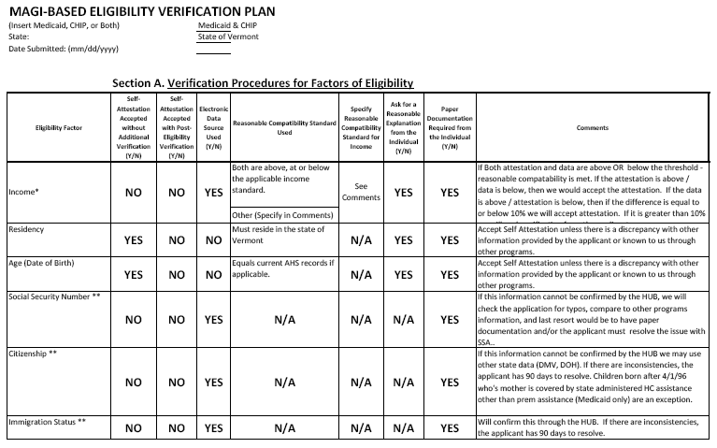
Self-Attestation Illustration for Eligibility (1 of 2)

Slide 29
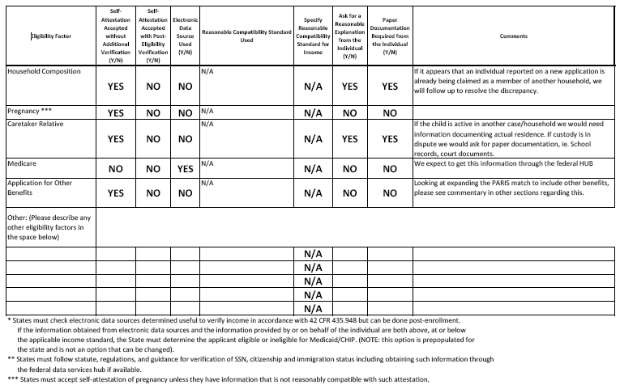
Self-Attestation Illustration for Eligibility (2 of 2)

Slide 30
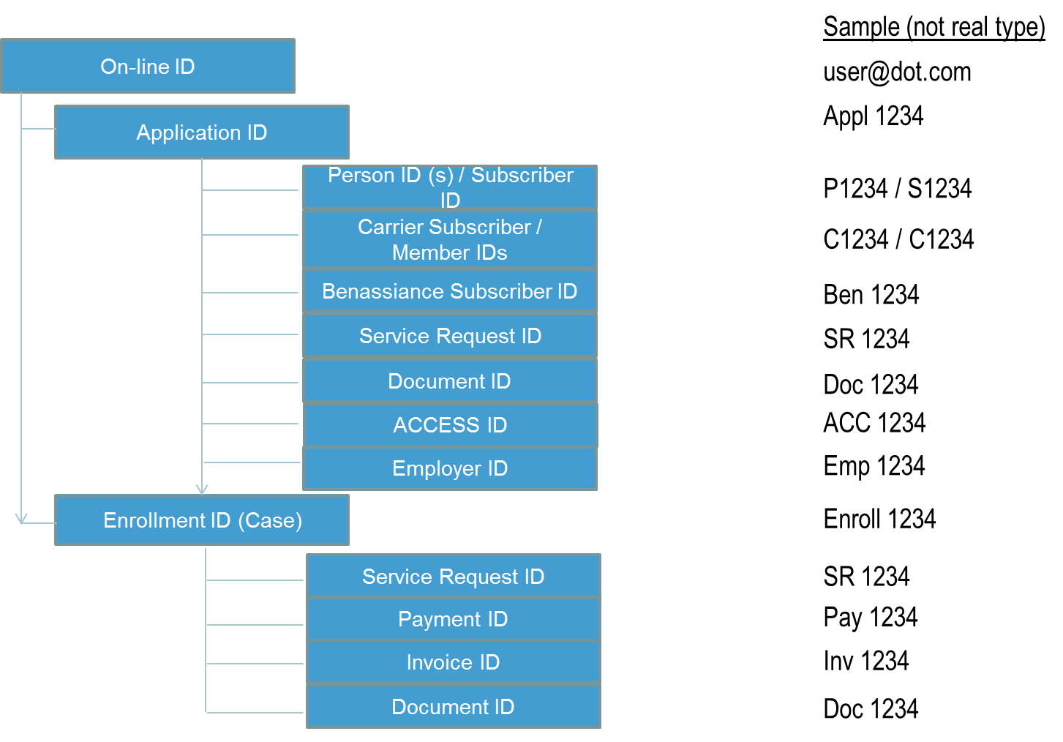
VT HBE IDs - Basic, Created by Individual

Slide 31
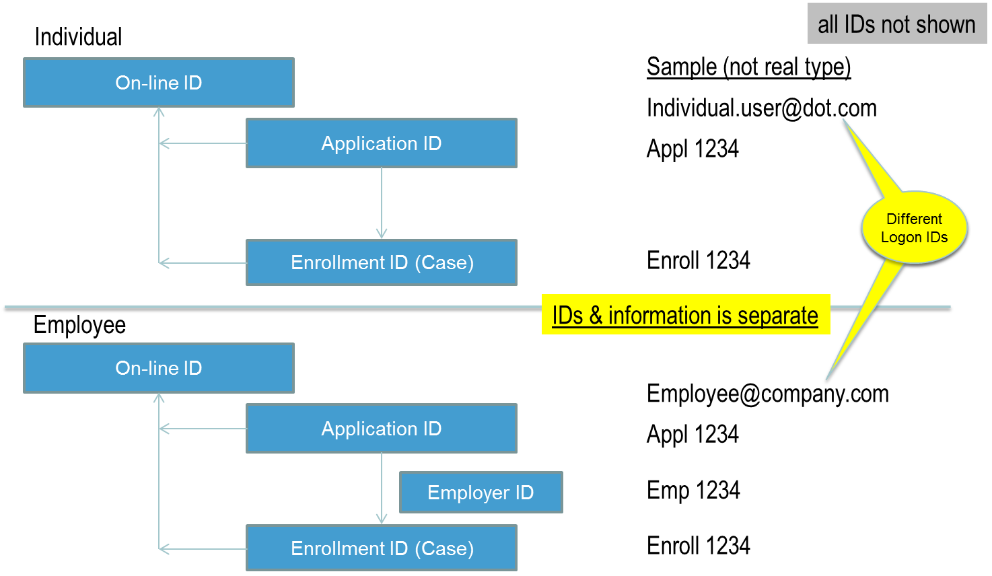
VT HBE IDs Individual & Employee

Slide 32
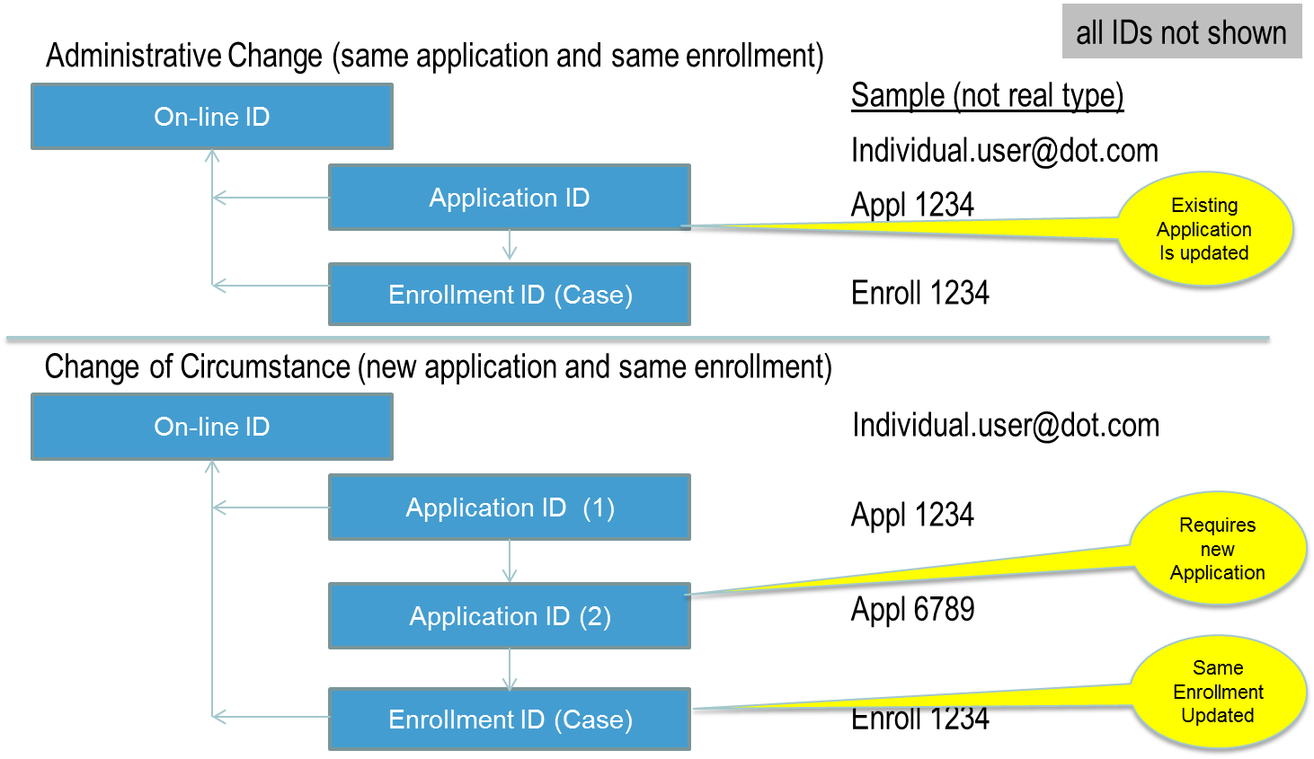
VT HBE IDs, Changes Administrative & Change of Circumstance

Slide 33
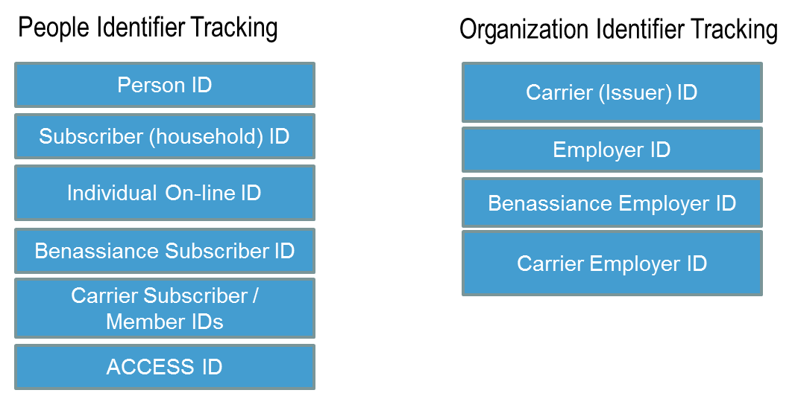
HBE Master Data Management (MDM) 01Oct2013
For October, the base requirement is focused around two items:
Establishing the technical foundation and prepare for future expansion
Tracking of Person and external Organization Identifiers

